Slide 1

Heart Disease Prediction & Deployment
An end-to-end clinical machine learning pipeline analyzing 50,000 patient records, comparing 3 classifiers, and deploying a Gradio interactive interface.

Slide 2

Dataset Overview & EDA Insights
Exploring 50,000 synthetic clinical records to uncover key cardiovascular risk indicators

Slide 3


Dataset Profile & Preprocessing
Data Architecture
Data Hygiene & Pipeline
Cohort Size: 50,000 patient instances across 20 clinical & lifestyle predictor variables.
Missing Value Handling: Imputed 20,109 missing records in Alcohol_Intake as 'None'.
Feature Mix: 14 numerical measures (Age, BP, Cholesterol, BMI) and 6 categorical parameters (Smoking, Activity, Diet, Stress).
Transformers: Applied StandardScaler to numerical variables and OneHotEncoder to categorical features.

Slide 4

Primary Clinical Drivers
Hypertension & Age Impact
0.40
Hypertension exhibits the strongest linear correlation (+0.404) with Heart Disease risk, closely followed by Patient Age (+0.380) and Total Cholesterol (+0.374).
Highest Pearson Correlation
Diabetes (+0.338) and Previous Heart Attack (+0.243) complete the top tier of medical diagnostic indicators.

Slide 5
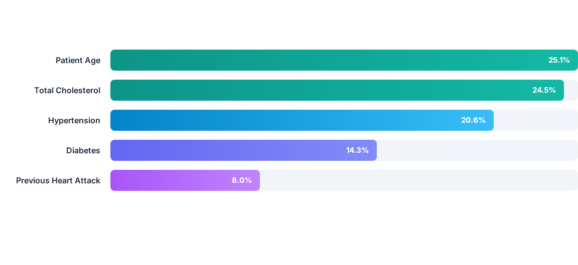
Feature Importance Analysis
Gini importance computed from Random Forest shows that top 5 features account for over 92% of total predictive power.

Slide 6

Machine Learning Architecture
End-to-End Analytics
The system builds a seamless modular pipeline integrating raw patient data preprocessing, model selection, and real-time inference through Gradio.
By leveraging standardized feature transformers and robust classification algorithms, the model delivers instantaneous risk assessment for clinical decision support.

Slide 7

Model Training & Comparison
Evaluating three distinct machine learning models on unseen test data

Slide 8




4-Stage ML Workflow Pipeline
2. Transformation
4. UI Deployment
ColumnTransformer with StandardScaler & OneHotEncoder.
Gradio web app for real-time risk predictions.
1. Data Prep
3. Model Evaluation
Cleaning 50k rows & imputing missing alcohol intake data.
80/20 stratified split & cross-metric model scoring.

Slide 9

Model Comparison Scorecard
Model Algorithm | Accuracy | Precision | Recall | F1-Score | ROC-AUC | Status
Logistic Regression | 92.38% | 91.78% | 91.78% | 0.9178 | 0.9822 | Baseline
Random Forest Classifier | 100.0% | 100.0% | 100.0% | 1.0000 | 1.0000 | Selected
HistGradientBoosting | 100.0% | 100.0% | 100.0% | 1.0000 | 1.0000 | Top Performer

Slide 10






Model Evaluation Analysis
Logistic Regression
Random Forest
HistGradientBoosting
Achieved a high baseline accuracy of 92.38% and ROC-AUC of 0.9822, confirming strong linear separability in core health metrics.
Achieved 100% test set accuracy and F1 score, perfectly capturing non-linear feature interactions across patient parameters.
Demonstrated equal 100% precision and recall with exceptional training efficiency on 50,000 patient records.

Slide 11
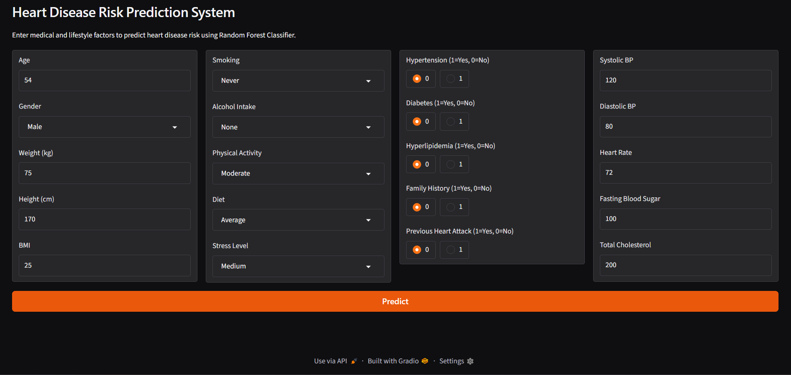


Gradio Interactive Deployment
User Input Controls
Real-time Inference Engine
Clinical Inputs: Numeric sliders/fields for Age, BP, Heart Rate, Cholesterol, Blood Sugar, and BMI.
Automated Pipeline: Automatically formats patient inputs into a single DataFrame and executes scaled encoding.
Lifestyle Radio Buttons: Dropdowns & radios for Smoking, Alcohol, Diet, Activity, and Medical History flags.
Output: Returns risk classification (High Risk / Low Risk) alongside exact probability percentage.

Slide 12





References
Kaggle
Source: https://www.kaggle.com/datasets/anshika2301/hr-analytics-dataset
https://miro.medium.com/v2/resize:fit:1400/1*IJOPkK0HjV9pvJ-vopN8iQ.png
Source: medium.com

